Slide 1

Fundamentals of Containerization Technology
Presenter: Arun Prasad

Slide 2
Course Outline
Virtualization : Overview
Containerization : Introduction
Docker : Fundamentals
Kubernetes : Fundamentals

Slide 3

Virtualization : Overview

Slide 4
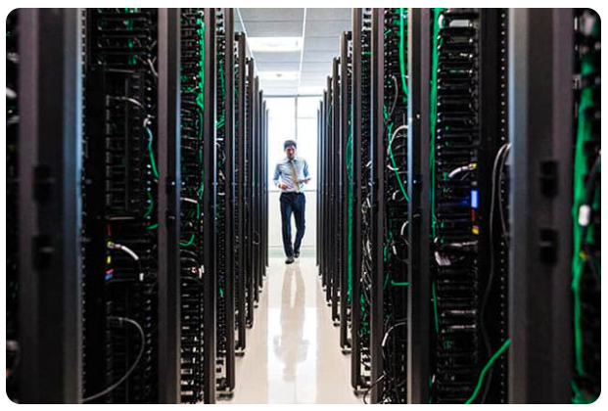
Data Center – Complexity starts from here!
Physical facility to store applications and data
It consists of(not limited to):
Routers
Switches
Firewalls
Storage Systems
Servers

Slide 5
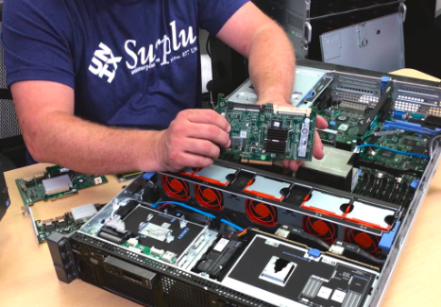
Servers
Resembles a personal computer as it is made of the same basic components like power supplies, memory, and CPUs.
But has advanced features in terms of processing power, resource management etc.
Also employs redundancy and swappable components.
Dell PowerEdge R70

Slide 6
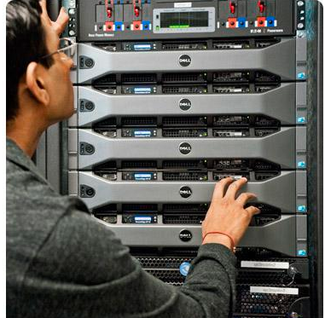
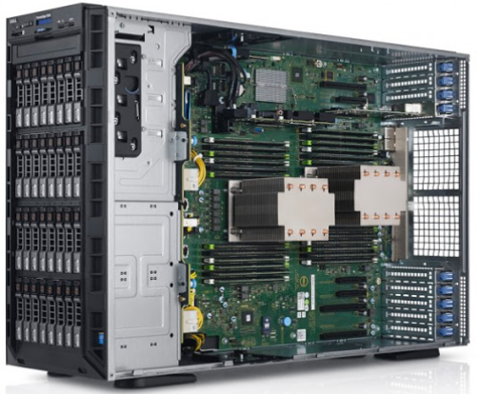
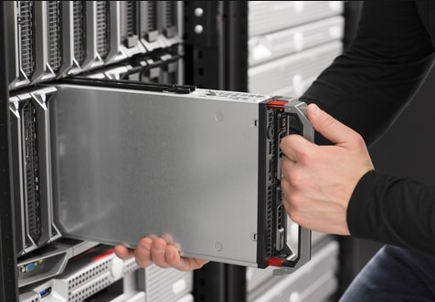
Types of Servers:
Dell PowerEdge T630 Tower Server
Dell PowerEdge R720 Rack Server
Blade Server

Slide 7
Hardware/Bare-metal servers require an operating system to function. The installation process might be slightly different from the way how we do it for a personal computer.
Check out the below link that walks through OS installation on a Dell bare metal server:
https://www.dell.com/support/article/en-in/sln129177/how-to-install-the-operating-system-on-a-dell-poweredge-server-os-deployment?lang=en
Dell PowerEdge R70

Slide 8

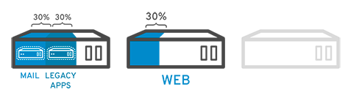
Why Virtualization?
The capacity of a single server is so large that is nearly impossible for most workloads to use it effectively.
To overcome this, between 1960-1970, virtualization technology emerged.
By using virtualization, we can split a single hardware server into multiple isolated virtualized servers that provide processing power.
Dell PowerEdge R70
Traditional approach
Using Virtualization

Slide 9
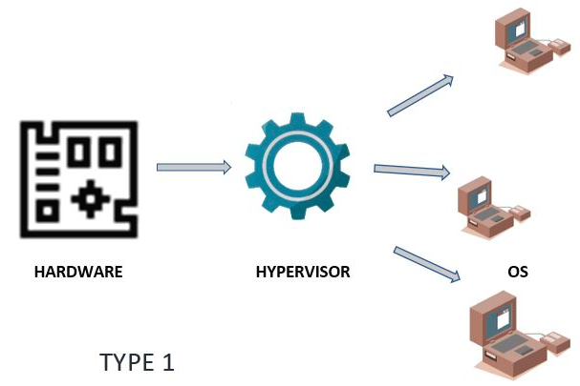
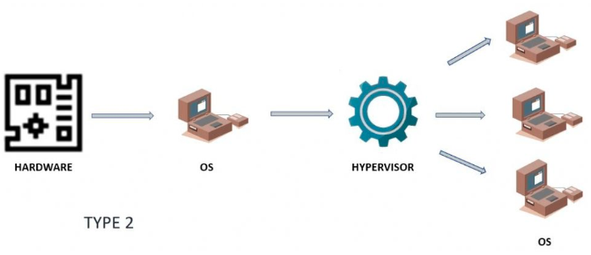
How do we Virtualize a Hardware? :Hypervisor
Bare-metal/Hardware based Hypervisor
Software Hypervisor
Hypervisor is installed directly on the hardware and virtualizes the hardware platform so that multiple virtual machines can utilize it.
Ex: VMWare vSphere ESX/ESXI, KVM, Microsoft Hyper-V
A Software based Hypervisor is installed on top on an Operating System running on a Hardware. Using this software multiple virtual machines can be created.
Ex: Oracle VirtualBox and VMWare Player
Dell PowerEdge R70

Slide 10
Pitfalls of a Virtual Machine
Low performance when compared with physical server.
Any vulnerability in host OS also impacts the VM’s running on top of it.
Tedious process to transfer a VM from one Host to another Host.
Occupies more space since it runs a complete operating system.
Considerable amount of boot time.
Dell PowerEdge R70

Slide 11

Containerization : Introduction

Slide 12
Why Containerization?
Even though virtual machines and containers have their own use cases, containerization technology addresses few drawbacks of Virtualization.
However, it cannot be a complete replacement of virtualization.
Containers are light weight isolated processes that share kernel of the Host OS instead of holding a separate full fledged OS.
Containers can be easily shifted from one host OS to another (provided the host is running a container engine).
When it comes to resource consumption, container’s utilize less resources and can be created or destroyed easily compared to a vm.
These features make containers a suitable choice to package an entire application with all its dependencies as a bundle.
This bundled application can then be easily transported to a different Host running same or different operating system, stored in a repository and can be downloaded/pulled whenever it is required.
The bundled package can also be tagged for changes.
Dell PowerEdge R70

Slide 13

VM vs Containers
Dell PowerEdge R70

Slide 14
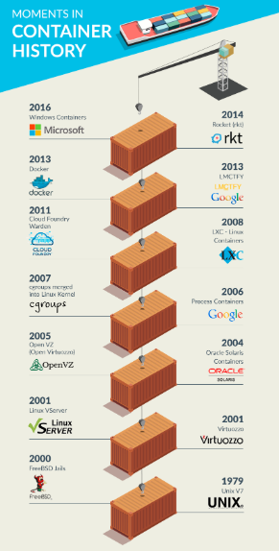
Evolution of Container Technology

Slide 15
Jail a process: chroot
On a Linux operating system, every process has its own current working directory which in most cases would be the directory “/”. ( This is not equivalent to /root folder).
Use “pwdx <pid>” to check the root directory of a process.
However, on a Linux operating system, the working directory of a process (and its child process) can be changed by using “chroot” abbreviation of “Change Root” command.
The main use case of “chroot” is to perform maintenance on systems where booting and/or logging is no longer possible.
It provides an isolated directory wherein a user can perform activities or run tests safely without disturbing other directories available on the file system.
Dell PowerEdge R70

Slide 16
A process or command that is executed in such a modified environment cannot access the files and directories outside its own root directory.
Due to this behavior the process is called as “Jailed Process”, the environment as “chroot Jail” and the directory as “Jailed Directory”.
The command is: “chroot <new_root_dir> [command]”
But this isn’t simple as said. In order to run a process/command in a jailed directory, we have to populate the jailed directory with all the dependencies of that command and additionally maintain the folder structure of these dependencies.
Dell PowerEdge R70

Slide 17
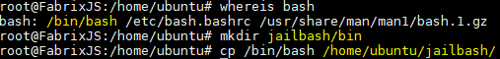
Let’s Jail the Bash command
Step1: Identify and create a folder that will be used as Jailed Directory:
Step2: The bash command is available under /bin directory. So create a ‘bin’ directory under our jail directory. Copy the actual bash command from “/bin” to “~jailbash/bin”
Dell PowerEdge R70

Slide 18
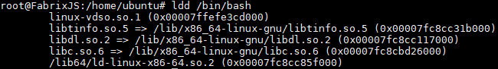
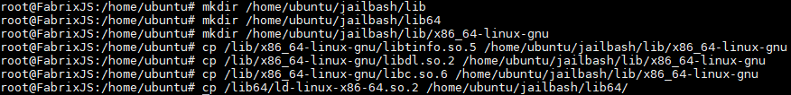
The bash command depends on few other libraries. Use the below command to identify the dependencies of bash command:
Based on the output, the dependencies need to be stored under a directories “lib” and “lib64”. Create these directories under jailed directory and copy the dependencies:
Dell PowerEdge R70

Slide 19
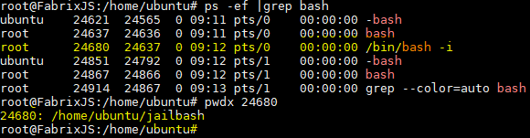
Time to test. Execute the below command to spawn a bash process with root directory mapped to our jailed directory. You might end up with an similar output if you executed the command on any modern ubuntu os:
Let’s verify if the bash command is mapped to the directory that we created. Leave the current session as it is and open a new session or try duplicating the current session and execute the below command:
Dell PowerEdge R70

Slide 20
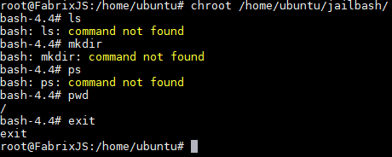
If you try executing some commands from the jailed bash you will notice that it isn’t available to this jailed bash. However few commands that are part of bash itself can be executed like ‘pwd’.
Type exit to terminate the jailed bash
Dell PowerEdge R70

Slide 21
Containerization is not only about process isolation.
In order to run a container with its own stack of resources, a combination of Linux Kernel features are involved:
Namespaces: Creates an isolated environment for a process. There are 7 types of namespaces:
Mount - isolate filesystem mount points
UTS (Unix Time Sharing) - isolate hostname and domain name
IPC (Inter process communication) - isolate inter-process communication resources
PID (Process ID) - isolate the PID number space
Network - isolate network interfaces
User - isolate UID/GID number spaces
Cgroup - isolate cgroup root directory
Dell PowerEdge R70

Slide 22
Cgroups: Resource limits
memory
CPU
block I/O
Network
seccomp-bpf: For security. It filters which system calls can be executed by the container.
Dell PowerEdge R70

Slide 23

Thank you

